Slide 1

sdev1701
Day 15: Styling Text: Typography for Web

Slide 2
Web Typography

Slide 3
INTRODUCTION TO TYPOGRAPHY
The word "typography" comes from the Greek τύπος - "imprint" and γράφω - "write" and means the artistic design of text using fonts, symbols and signs.
Specialists in such areas as web design, graphic design, classic and web layout, and printing work directly with typography. But basic knowledge of typography will be useful to marketers, editors, content managers, and brand managers.
Working with fonts often seems to be the most difficult stage of work, not only for beginners, but also for experienced web designers.

Slide 4
TYPOGRAPHY'S ROLE IN DESIGN
Typography is an integral part of any web project. Every website/landing page and mobile app is designed using typography elements. Headings, text blocks, buttons and forms, and even image captions are all created based on typography.
Text is the primary tool for conveying information on web pages and mobile app pages. A designer may not use any decorative elements, compositional techniques, or non-monochrome colours, but he or she will still be able to create a page that will convey the necessary message to the user.

Slide 5

COMMUNICATION
The first function that typography performs will be communicative.
With the help of text, a web designer conveys ideas, offers and brand values ​​to users. Text is a communication tool that is in many ways superior to images. With the help of correctly designed text on a website, you can convey all the necessary information that cannot always be conveyed in the form of a single image.

Slide 6
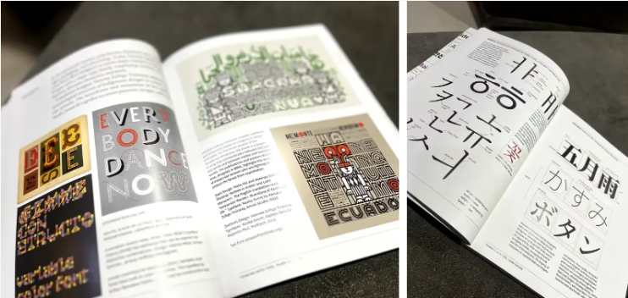
AESTHETIC
Using various styles, fonts, and typefaces, the designer creates a unique typographic composition that fits organically into the overall composition of the page.
Typography tools can add decorativeness to the page and emphasize the individual style of the brand (identity).

Slide 7
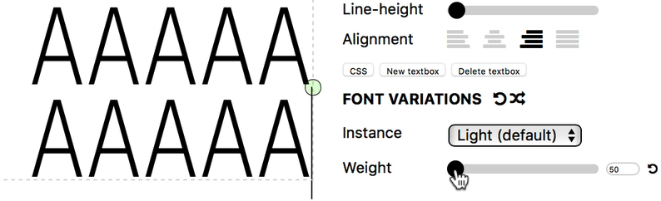
IMPORTANT FUNCTIONS OF TYPOGRAPHY
Demonstrate the visual hierarchy of the page,
Highlight the main and secondary elements,
Set emphasis on important blocks on the page.

Slide 8

BASIC TERMINOLOGY
The fundamental element of typography and font is the letter. Each letter is unique in its internal structure, which must be taken into account and which is transformed at the moment when the font is designed.
A set of letters and symbols that have certain design features is called a typeface.

Slide 9
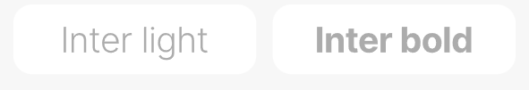
BASIC TERMINOLOGY
Within each typeface, there may be several sets of letters and symbols that differ in their style (weight, slant, density, and decorativeness) and size. These sets of letters and symbols are called fonts.
What ordinary people usually call a font is actually a typeface. For example, Arial, Helvetica, Roboto. But a group of symbols from a certain typeface with features of writing (for example, Light, Regular, Bold, etc.) is called a font. For example, Helvetica Light or Roboto Bold.

Slide 10

BASIC TERMINOLOGY
In CSS you can set this value using font-family
Sets the typeface(s).
Example:

Slide 11
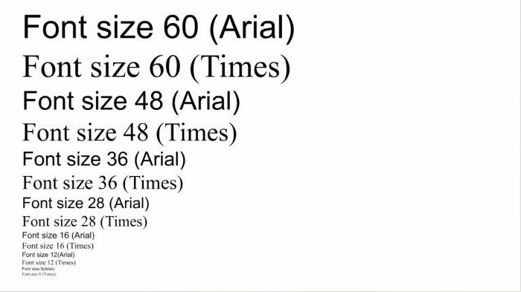
KEY MEASUREMENTS
Font size is the vertical height of a letter. This size is measured in pixels. One of the important characteristics of typography is leading, which is the distance between the baselines of adjacent lines of text. Leading should not be confused with line spacing, which is the distance from the baseline to the top of the lowercase letters on the next line.

Slide 12
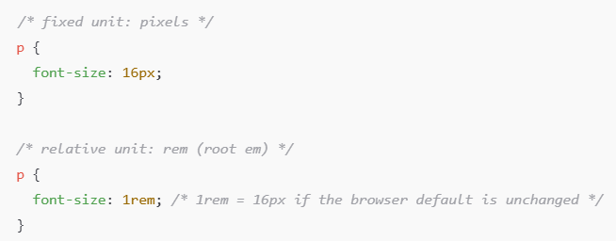
KEY MEASUREMENTS
Font size in CSS is set using
Example: A user with visual impairment increases their browser’s default font size.
If your site uses px, the text stays small.
If your site uses rem or %, the text automatically grows with their setting.

Slide 13
KEY MEASUREMENTS
Best Practice
Use rem for consistent, accessible font sizing based on the root element.
Only use px for things that should not scale, like borders or precise layouts
Fixed Units (px) | Relative Units (rem, em, %)
Set an exact, unchanging size | Scale up/down with user or device settings
Don’t respect browser zoom | Fully respect user zoom preferences
Can harm accessibility | Improve readability across screens and devices

Slide 14
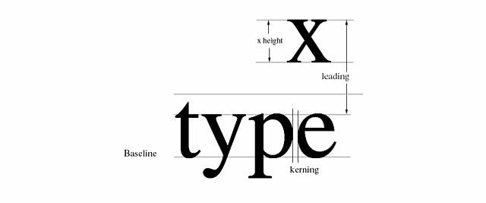
KEY MEASUREMENTS
One of the important characteristics of typography is leading, which is the distance between the baselines of adjacent lines of text.
Leading should not be confused with line spacing, which is the distance from the baseline to the top of the lowercase letters on the next line.

Slide 15
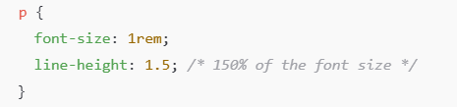
line-height: Spacing Between Lines
What it does:
Controls the vertical space between lines of text in a block (like paragraphs or headings).Helps make text more readable by avoiding cramped lines.
Best practice:
Use unitless values like 1.5, not px, so it scales with the font size.
This keeps spacing consistent even when font size changes responsively.
Why it matters:
Good line-height improves readability, especially for body text.
Too tight? Hard to read. Too loose? Feels disconnected.

Slide 16
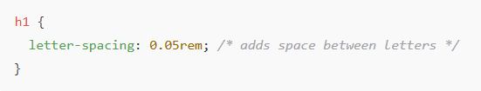
letter-spacing: Space Between Letters
What it does:
Controls the horizontal space between characters in text.
Helps improve legibility or adjust aesthetic for headings/logo
Use cases:
Slightly increase spacing for all-caps text or display fonts.
Tighten spacing for large headlines or design-focused elements.
Why it matters:
Can improve the visual flow of headings.
Enhances balance and legibility when used mindfully.

Slide 17
Other Font Styles
font-style: normal, italic, oblique
    Example: font-style: italic;
font-variant: normal, small-caps
    Example: font-variant: small-caps;
font-weight: normal, bold, bolder, lighter, or numeric 100–900
  Example:
    font-weight: bold;
    font-weight: 500;
text-transform: uppercase | lowercase | capitalize
text-align: left | center | right
font-stretch: ultra-condensed → ultra-expanded (only works if font supports)

Slide 18
FONT CLASSIFICATIONS

Slide 19
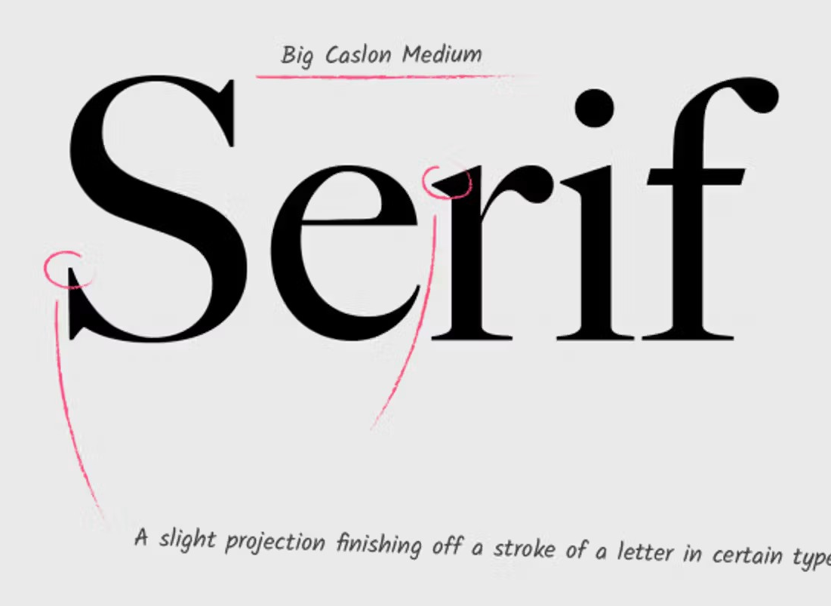
Serif Fonts
Serif fonts are one of the most popular and widespread types of fonts. These are elegant and sophisticated fonts that emphasize the high status of the project in which they are used.
Such fonts are traditionally associated with a high level of intelligence, wealth and confidence.
They are often used to create identities and websites of law firms, various insurance companies, translation agencies and banks.

Slide 20
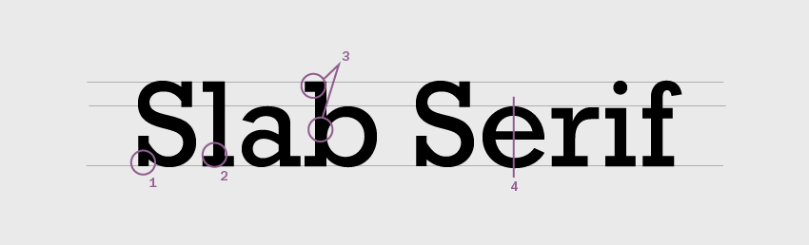
Slab serif fonts
They are similar to serif fonts, but they have more boldness and independence. The distinctive feature of these fonts is their square serifs.
The symbols and letters in these fonts look quite massive. These fonts are distinguished by their originality, but at the same time, they are clear and easy to perceive.
Slab serif fonts are suitable for those brands that want to maintain a certain amount of conservatism in their identity, but are ready for non-standard solutions.

Slide 21
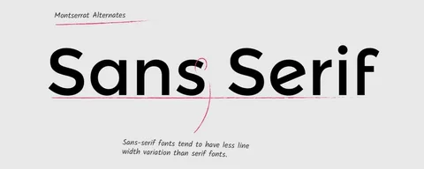
Sans-Serif Fonts
These are modern fonts that have gained recognition in minimalist design projects.
They are distinguished by their neatness, asceticism and simplicity.
Such fonts can be called universal, as they allow you to clearly convey the necessary message, and do not overload the interface.

Slide 22
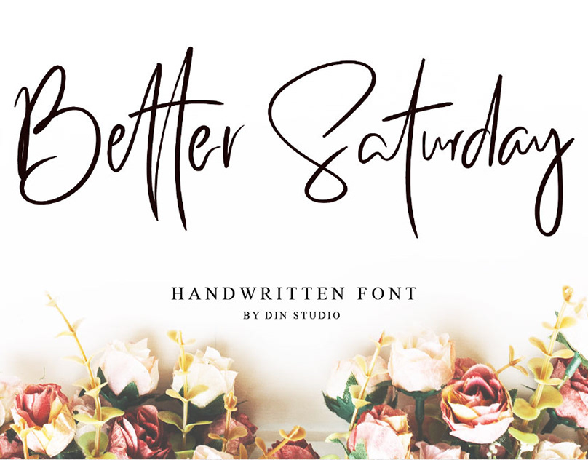
Handwritten fonts
These fonts are distinguished by their decorativeness, elegance and creativity.
They can be difficult to implement into a project, as they have a very original style.
Handwritten fonts can overload the design, so they should be used in small quantities.

Slide 23
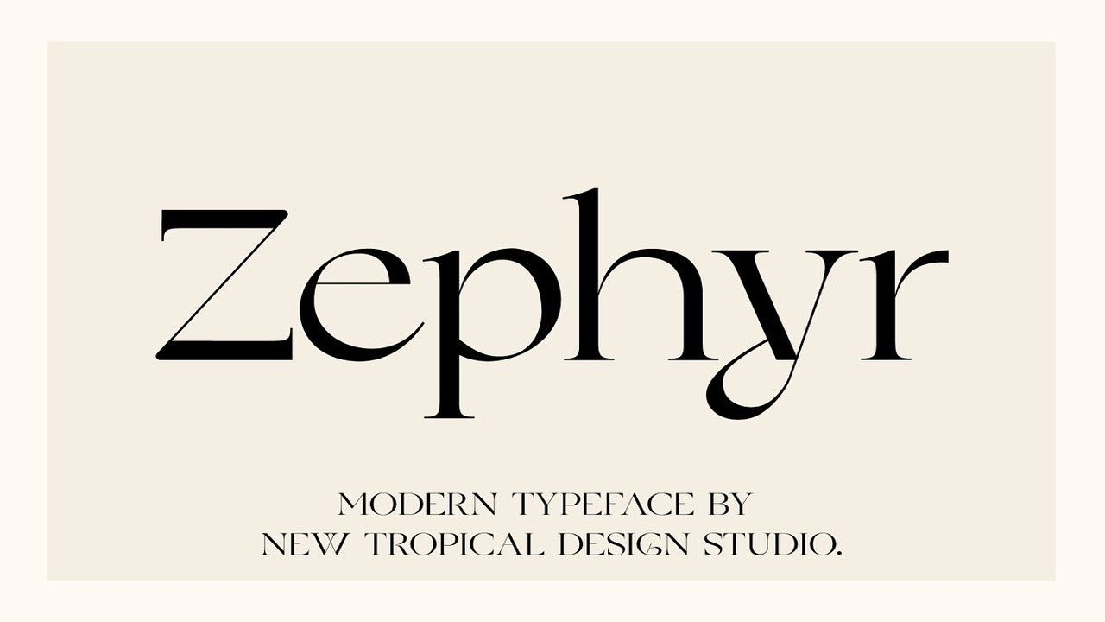
Modern fonts
These fonts are distinguished by their versatility and create the effect of novelty.
They often have a futuristic character.
Modern fonts are great for technology projects, the IT sphere, and projects related to education.

Slide 24
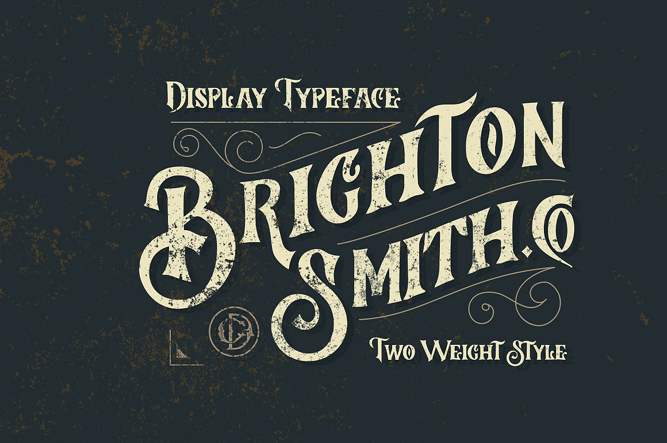
Decorative Font
Fantasy, fairy tale and unusual. Decorative fonts are distinguished by the maximum level of decorativeness.
These are fonts that should be used very sparingly, as they themselves are a bright decorative element and will compete with other elements of the page.
Decorative fonts are suitable for youth projects, creative companies and organizations specializing in art.

Slide 25
RULES OF TEXT FORMATTING

Slide 26
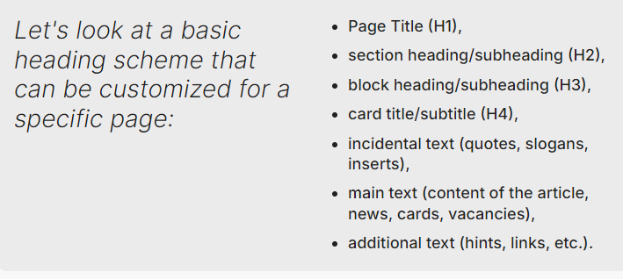
HIERARCHY AND STRUCTURE
All content on a web page should be structured by importance and priority. Only one font cannot be used for text formatting. The page should always have a heading and main text.
Additional subheadings and hint text, explanations, and additional information, which are formatted in the smallest font size, can also be used.
Elements such as size, colour, scale, frames and lines are used to highlight headings, subheadings and button texts.

Slide 27
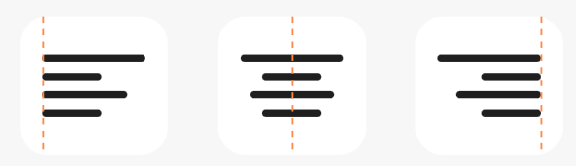
ALIGNMENT
Left alignment is the most convenient for reading text alignment. In rare cases, headings/subheadings and main text may be centred.
Right alignment is not used for texts (except for numeric values ​​in tables).

Slide 28
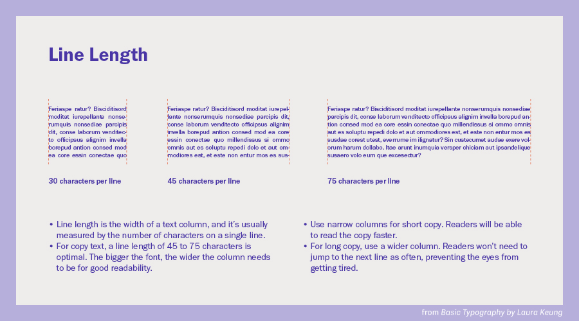
LIMIT LINE LENGTH
One of the main principles of typography is readability. Line length directly affects it.
The optimal line length for the user to maintain concentration and comfortably navigate the page is 45-70 characters.

Slide 29
GIVE PREFERENCE TO STANDARD FONTS
Despite the fact that various services and sources offer many font options and ready-made colour schemes for projects, their use is often not justified. The fact is that users are accustomed to standard fonts, so it is more difficult for them to perceive the original author’s fonts. They should be used only when necessary.
When choosing fonts, you also need to limit yourself in their number. It would be optimal to have up to 3 fonts on one site. Using more fonts makes the page visually less structured and spoils the layout on the page.
When choosing a typeface or font, make sure that the text remains readable at any size.

Slide 30
WEB SAFE FONTS:
Fonts that are pre-installed across most operating systems. Resources:
  Common Fonts for Windows/Mac
  CSS Font Stack
Web Fonts:
  Steps to Use Hosted Web Fonts:
  Choose a font.
  Preview the font.
  Choose styles, copy the <link> or @import code.
  Paste it inside your <head> section.
  Copy corresponding CSS font-family rule into your style.css. Done!

Slide 31
:nth-child( )
Notes:
https://developer.mozilla.org/en-US/docs/Web/CSS/:nth-child

Slide 32
:nth-child(n)
Selects an element from a list of siblings.

Slide 33
Examples
section p:nth-child(3) selects the third paragraph in a section.
li:nth-child(4n) selects every fourth list item.
tr:nth-child(even) selects every even table row (starting with the second row).

Slide 34
:first-child,
:last-child,
& :only-child
Notes:
https://developer.mozilla.org/en-US/docs/Web/CSS/:first-child
https://developer.mozilla.org/en-US/docs/Web/CSS/:last-child
https://developer.mozilla.org/en-US/docs/Web/CSS/:only-child

Slide 35
:first-child
This selects the first element in a list of siblings.
:last-child
This selects the last element in a list of siblings.

Slide 36
Examples
section p:first-child selects the first paragraph in any section.
li:last-child selects the last list item.

Slide 37
:only-child
If there’s an element without any siblings, it will get selected.

Slide 38
<!-- HTML -->
<div>
<div>I’m the first sibling.</div>
<div>I’m the second sibling.</div>
<div>I’m the third sibling,
<div>but I’m an only child</div>.
</div>
</div>
/* CSS */
div:only-child {
color: chartreuse;
}

Slide 39
Summary and Reflection

Slide 40
REFLECTION PROMPT
What typography techniques will you apply in your web projects?

Slide 41
NEXT STEPS:
Explore Google Fonts and apply different font pairings in a practice web page and complete Homework exercise.

